Slide 1
Private Ethereum Network Lab Assignment

Slide 2
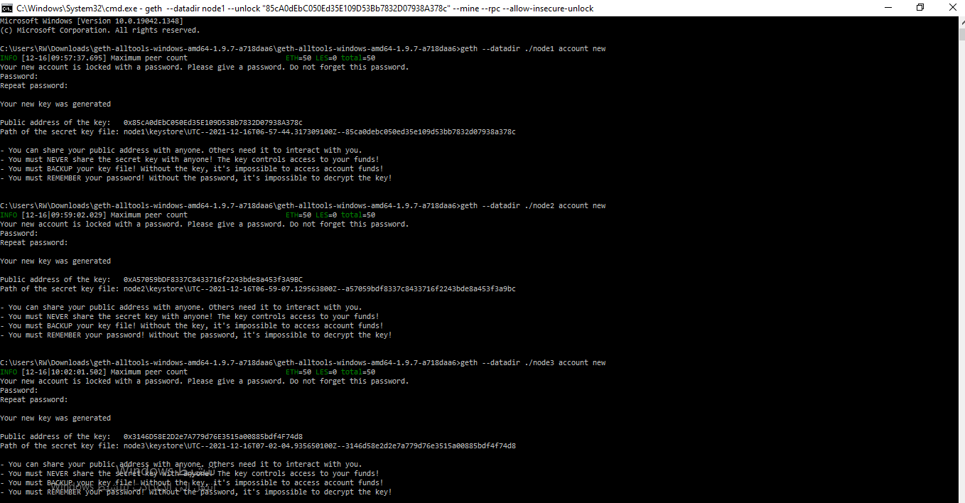
Part 1. Network configuration

Slide 3
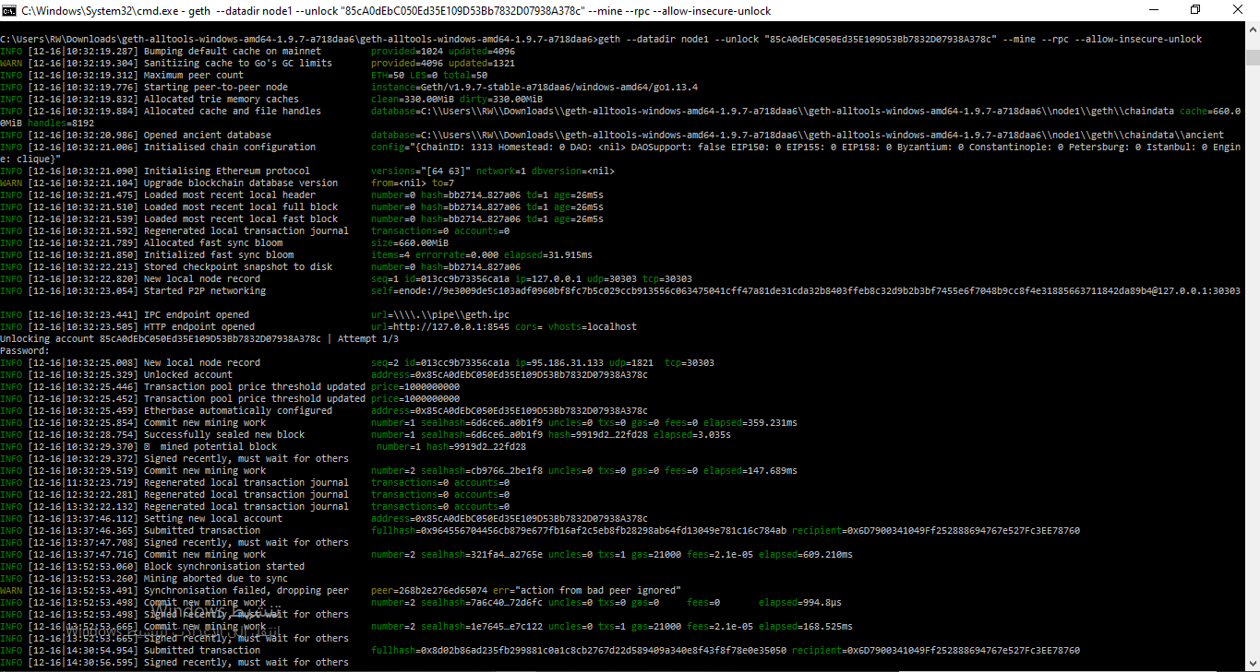
Part 2. Launching our Network

Slide 4
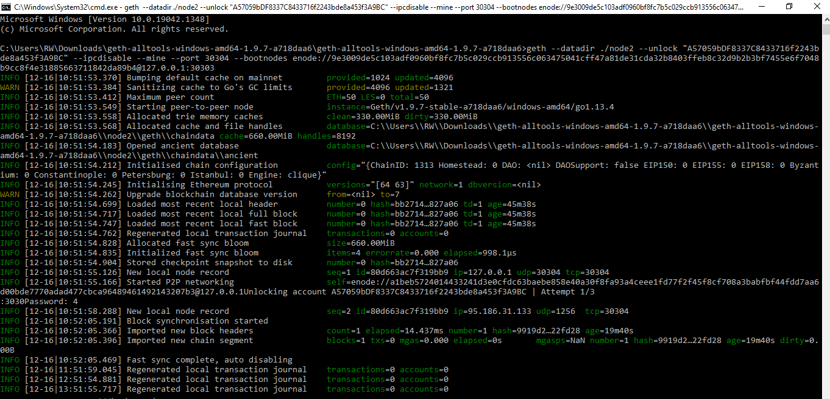
Part 2. Launching our Network

Slide 5
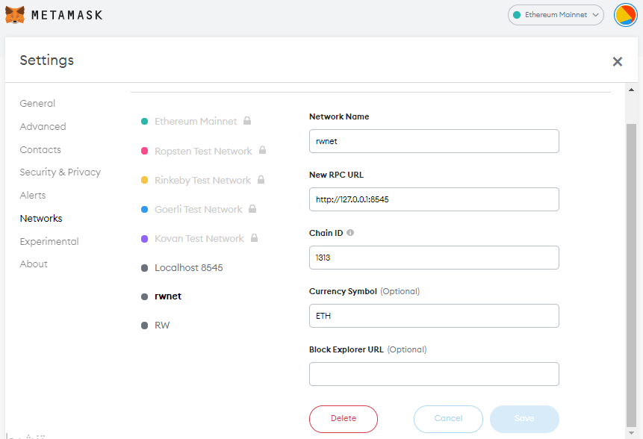
Part 3. Connecting from Metamask

Slide 6
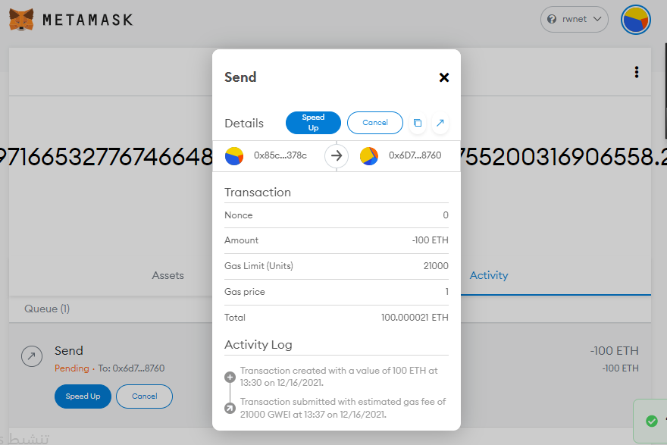
Part 3. Connecting from Metamask

Slide 7
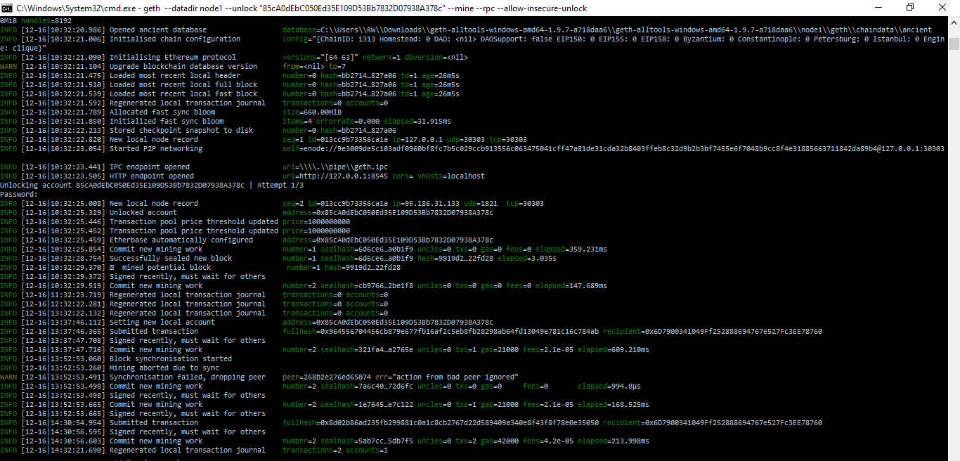
Part 3. Connecting from Metamask

Slide 8

THANKS!

